Slide 1
Intermediate Code Generation

Slide 2
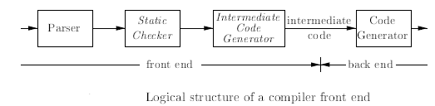
Logical structure of a compiler front end
In the analysis-synthesis model of a compiler, the front end analyzes a source program and creates an intermediate representation, from which the back end generates target code.
where parsing, static checking, and intermediate-code generation are done sequentially; sometimes they can be combined and folded into parsing.
Static checking includes type checking, which ensures that operators are applied to compatible operands. For example, static checking assures that a break-statement in C is enclosed within a while-, for-, or switch-statement

Slide 3

Compiler might use a sequence of intermediate representations
The term three-address code comes from instructions of the general form
x = y op z with three addresses: two for the operands y and z and one for the result x.
In the process of translating a program in a given source language into code for a given target machine, a compiler may construct a sequence of intermediate representations.
A low-level representation is suitable for machine-dependent tasks like register allocation and instruction selection. High Level representation a tree like structure.

Slide 4
Variants of Syntax Trees - DAG
A directed acyclic graph (hereafter called a DAG) for an expression identifies the common subexpressions (subexpressions that occur more than once) of the expression. Nodes in a syntax tree represent constructs in the source program; the children of a node represent the meaningful components of a construct.
Directed Acyclic Graphs for Expressions
Like the syntax tree for an expression, a DAG has leaves corresponding to atomic operands and interior nodes corresponding to operators.

Slide 5
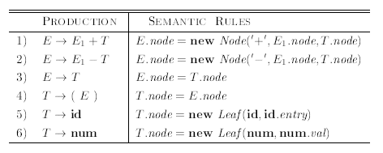
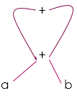
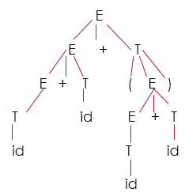
Syntax-directed definition to produce syntax trees or DAG's
DAG
Input string to be represented
a + b + (a + b)
Syntax Tree
Steps for constructing the DAG
p1= Leaf(id, entry-a)
p2 = Leaf(id, entry-b)
p3= Node(‘+’,p1,p2)
p4=Leaf(id, entry-a) = p1
p5=Leaf(id, entry-b) = p2
p6=Node(‘+’,p1,p2) = p3
p7= Node(‘+’,p3,p3)
Input string to be represented
a + b + (a + b)

Slide 6
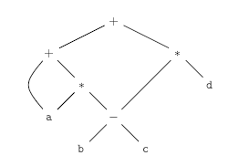
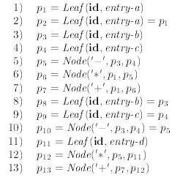
Construct DAG for the expression a +a*(b-c)+ (b-c)*d
Steps for constructing the DAG
DAG

Slide 7

Construct the DAG for the expression (assuming + associates from the left)

Slide 8
Tutorial Questions
1. A-> L M { L.i=f(A.s); M.i=f(L.s); A.s=f(M.s); }
2. A->Q R { R.i=f(A.i);Q.i=f(R.i); A.s=f(Q.s); }
Is the above definitions S-Attributed or L-attributed?

Slide 9
Construct Activation Tree and Activation Record for the given program
main(){
printf(“%d “, fib(5));
}
int fib(int num)
{
if(num == 0 || num == 1)
return num;
else
return fib(num-1) + fib(num-2);
}

